Slide 1
SchedulEd
CS 691 Asynchronous
Capstone
Team 1
Professor Henry Wong
Spring 2025

Slide 2

Agenda
Team Member Roles and Responsibilities
Problem Statement
Project Description
Personas
Technologies
Algorithms
Project Schedule
Team Working Agreement
Retrospective
Group Wiki Page

Slide 3
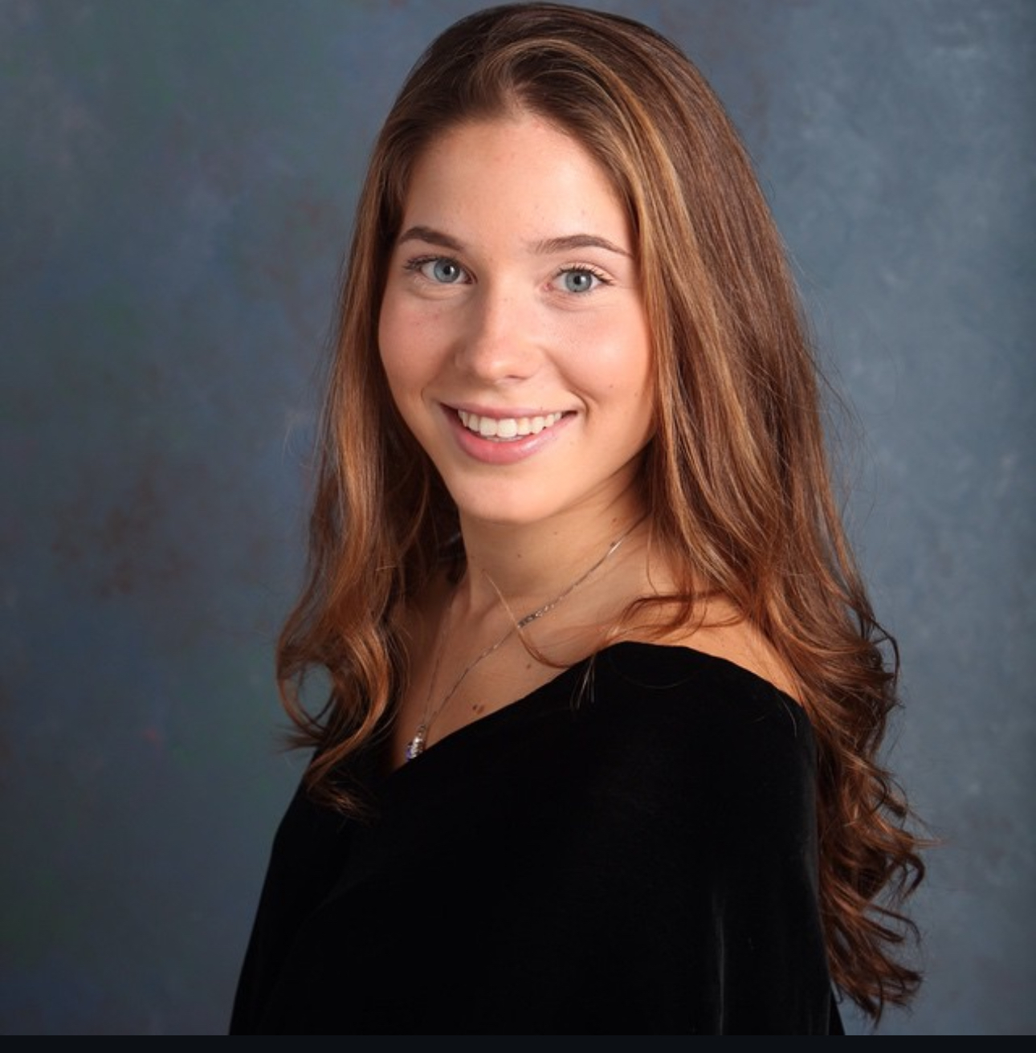
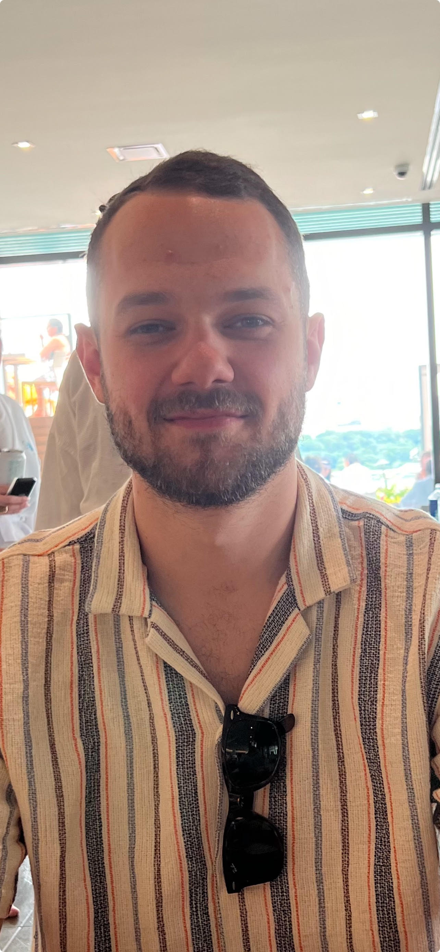
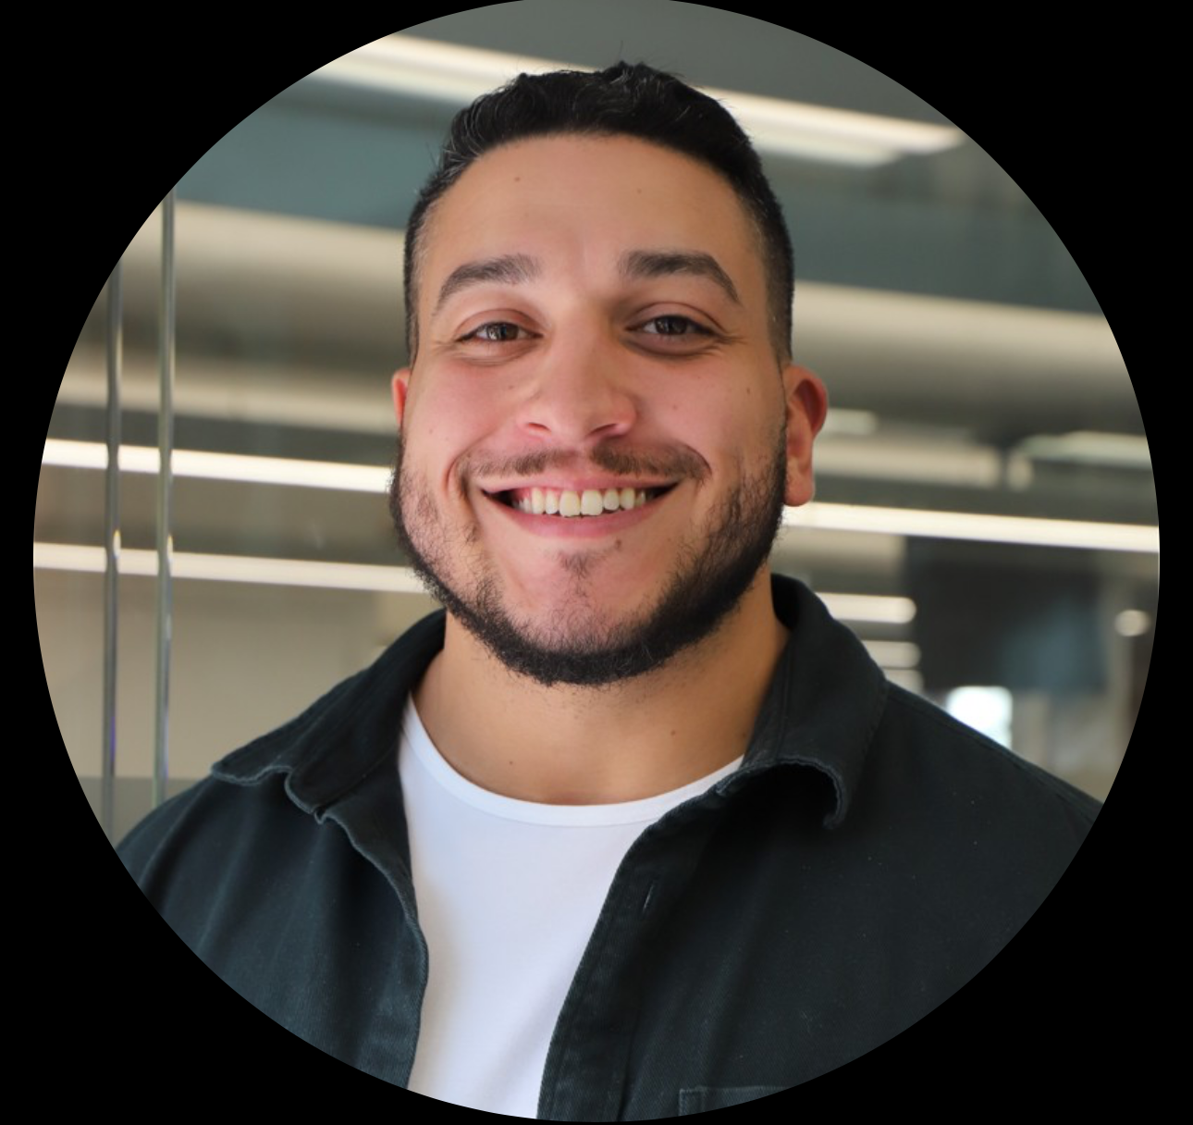
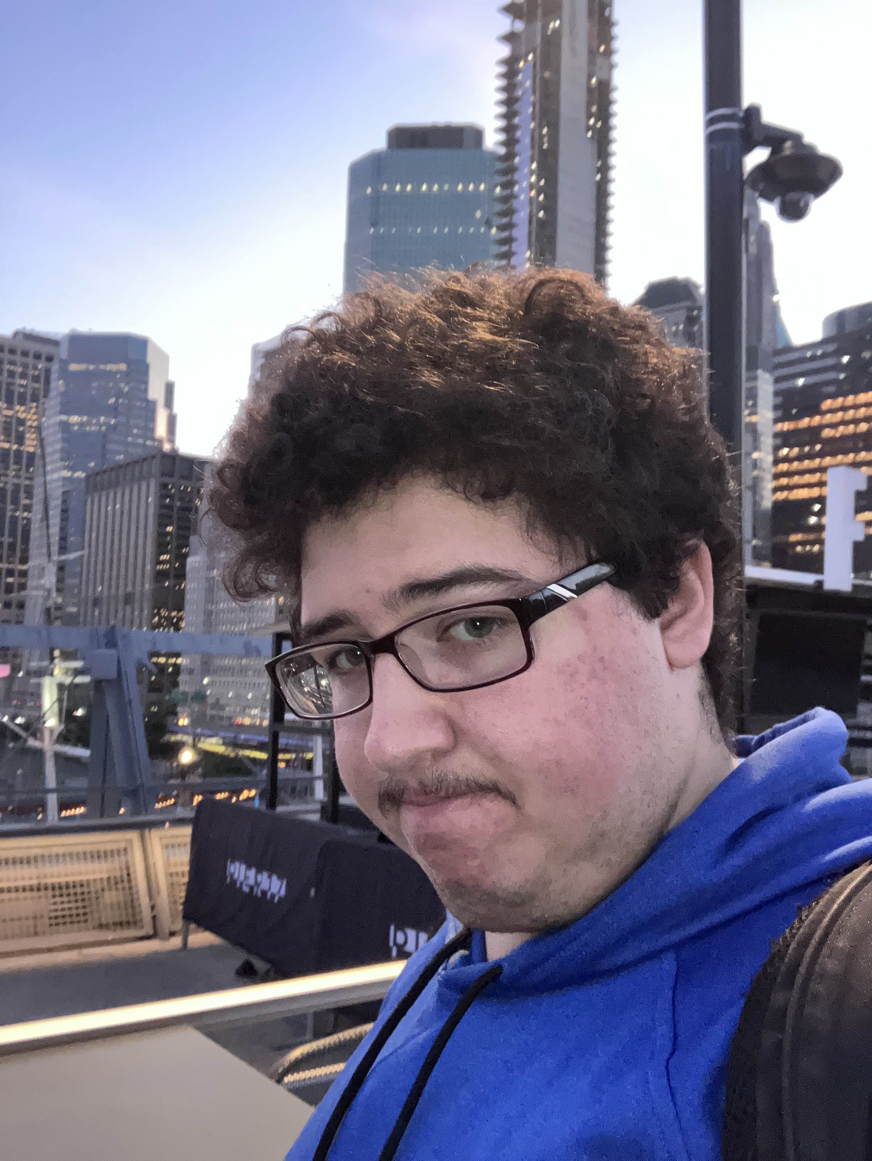
Team Members
Sabrina Scaccio: Scrum Master / Developer
Justin Rivera:
Front End Developer
Thomas D'Anna: Front End Developer
Victor Zapata:
Back End Developer

Slide 4

What Problem are we solving?
Our tutor scheduling app will help solve several key issues:
It will help alleviate scheduling conflicts:
It will help students, teachers, and parents find a mutually available time that works for all and there would be no guessing who is available at what time. It will help avoid missed sessions, and back and forth communication.
It will assist in Time Management:
As a tutor, one must prepare for each session, which requires a lot of lesson planning. This would provide the tutor with an organized schedule that allowed the individual to plan and make the best use of their time. Instead of spending time trying to communicate with multiple parents.
It will help remind students/parents of their session:
The app will send reminders by sending notifications, which would help reduce no-shows, or showing up to a house and no one is there.
It will create more flexible bookings:
If a student needs to cancel, they would be able to do it through the app. If they wanted to reschedule their session, they could see what time slots are available and select a time that works for them and the tutor! It would also help avoid doing double bookings (which most certainly happens if you do not write it down or have somewhere to manage it)

Slide 5
What Problem are we solving?
Our tutor Scheduling app will help solve several key issues:
It will provide parents/students with resources:
The app will allow the tutor to upload a copy of all the skills covered in the session. The teacher could also upload extra resources that would be useful to the parents and the students. This ensures the parents are aware of what topics are covered in the session.
It will help improve overall communication:
The app will include a chat feature, so if the parent wants to leave a special note, the app will allow the parent to privately message the tutor, so that there is effective communication happening on all ends. It would also allow the tutor to let the parents know of any issues that may be arising, or positive feedback that would be helpful for the parents.
It will assist in tracking payments:
The app will allow parents to track their history and notify them how much they owe. They may not be able to pay through the app, that would be something we could add, but it will allow the tutor to select if the parent has paid, and the parent would be able to see past sessions and payment history.

Slide 6

Project Description
ScheduleEd is a scheduling app that will assist teachers, parents, and students with the process of booking, managing, and tracking tutoring sessions. This app will focus on alleviating scheduling conflicts among all involved. Often, students have various commitments after school that are hard for the parents to manage. The times of these various extracurricular activities change. This has a trickledown effect on the teachers. This app will allow parents to book with a more flexible approach. They can go week by week, selecting times that work for them and their child. This app will eliminate scheduling conflicts, reduce ineffective communication, and avoid double-bookings and no-shows. In just the tap of a button, parents and students will be able to book, cancel, and reschedule appointments! The app will remind students/parents of their sessions and will allow the tutor to have a better scope at their week. It also will allow the tutor to notify parents of available times, rather than going back and forth, guessing what time will work. This app will aid many teachers, private tutors, and tutoring centers with a way to manage their learning schedule in a much more organized fashion.

Slide 7

Persona 1
Kathy is a private tutor working both online and in-person. While she enjoys teaching, managing her growing client base has become increasingly difficult. She often struggles with overbooking and scheduling conflicts, as manually tracking appointments leads to occasional double bookings or missed sessions. With an automated scheduling system, students could book sessions based on her availability, preventing conflicts and last-minute mix-ups. A student profile feature would help her store session notes and track progress efficiently, ensuring personalized lesson plans for each student.
Kathy - Wants a comprehensive tutor scheduling planner for managing multiple clients.

Slide 8

Persona 2
Jake is a 16-year-old high school student juggling multiple tutoring sessions alongside his regular schoolwork and extracurricular activities. He often forgets about scheduled lessons or struggles to find time for rescheduling when conflicts arise. He has a hard time keeping track of assignments and notes from his tutoring sessions, often misplacing important study materials. With automated reminders, he would never miss an appointment, reducing last-minute cancellations and lost study time. A built-in calendar would help him visualize his schedule, ensuring he doesn’t double-book tutoring with other commitments. A session tracking feature would allow him to store lesson notes, assignments, and key takeaways in one place, making it easier to review material when studying.
Jake – Looking for centralized app for managing tutoring sessions and study material

Slide 9

Persona 3
Debra is a busy mother of 3, trying to balance her work schedule while ensuring her 10-year-old daughter stays on top of her tutoring sessions. Debra often finds it challenging to keep track of lesson times, and her daughter's overall progress. In the chaotic life of a parent of multiple children, tutoring schedules sometimes slip through the cracks, leading to missed or forgotten sessions. She also struggles to stay updated on what Emily is working on in her sessions, relying on scattered notes from tutors or brief updates from her daughter. A session log feature would provide insight into Emily’s progress, giving Debra access to lesson notes and assignments so she can stay informed and involved in her child’s learning. A tutor scheduling app would be a game-changer for Debra, allowing her to keep all of Emily’s tutoring information in one place.
Debra - Keeping track of child's appointments and progress.

Slide 10




Technology
Frontend
Backend

Slide 11
Algorithm
Authentication
Allow user to secure login and have their data saved in a database.
Backtracking Algorithm
Make suggestions for better schedules

Slide 12
Project Schedule
 | Start | End
Sprint 0 | January 21st | February 10th
Sprint 1 | February 11th | March 10th
Sprint 2 | March 11th | April 7th
Sprint 3 | April 8th | May 5th
Weekly Meetings!
Wednesday @ 8pm!

Slide 13
Team Working Agreement
All team communication will occur using Microsoft Teams/I-Message
We remind each other that we are all in this together, and when conflicts do arise, we tackle them as a team and will help guide each other.
Meetings will be held using Microsoft Teams. We will meet weekly on Wednesdays @8:00 pm. We will add meetings as needed, to stay on top of deadlines. Meetings will be about a half hour.
At the beginning of each sprint, we will hold a sprint planning meeting, in which everyone is given their tasks.
Before the sprint is over, we will hold a meeting on our retrospectives.
Each team member will understand their role and what they are responsible for.

Slide 14
Team Working Agreement CONT.
Everyone will adhere to the due dates and the due date of when we want tasks done, will be discussed at the meeting.
Each team member has their own task but is reminded that we are a team, and things may not go as smoothly for others.
When there are conflicts within your own task, it is required that you tell the team immediately so that they can assist you and there are no delays in due dates.
Each team member is asked to come to the meetings fully prepared with their task.
We will continue to learn through this project and produce new innovative ways to tackle this capstone project.
Final work should be submitted as follows:
The team has reviewed your work
There are no errors within your code
All tasks were tested
Work meets the criteria of the class
Code is uploaded to Github
All aspects of the sprint are complete

Slide 15

Retrospective (SS)
What went well?
We all agreed to use Microsoft Teams to communicate meeting times and conflicts.
We were all able to pick an idea that we all agreed upon easily. Sabrina and Victor have personal uses for this app, which makes it more meaningful and purposeful.
We all communicated effectively and felt good at the end of the meeting and had a clear goal.
We divided the tasks rather quickly and evenly.

Slide 16
Retrospective (SS)
What could we improve?
We all agreed for the following sprints that time management is going to be crucial. We began sprint 0 a little delayed and want to avoid making errors due to time constraints.
We agreed to be very specific with what tasks each person must do to avoid overlap and frustration.
We agreed to do a better job of documenting the meetings and deciding who will take notes for the meeting that everyone will have access to.
We agreed that every meeting we will began by evaluating our progress towards our goal.
We will re-evaluate areas of improvement after every sprint.
We will continue to build on our skills and continue to do research that will enhance our project.

Slide 17
Group Wiki Link
https://github.com/htmw/2025SA-Team1/wiki

